Slide 1

H
CATEGORY H
Intensive Behaviour
Intervention or Serious
Mental Illness
Liam O'Connor • Grade 10 • Adapted program
Notes:
Presenter 1. Say who we are, that Liam is not a real student, and what the three parts of the talk are.

Slide 2







CATEGORY H
H
What the category means, and what it does not mean
What Category H means
Our student
Students who need the most support at school.
What can he already do?
What is getting in the way?
Liam O'Connor • Grade 10
Mood and energy change a lot
What support will help?
Sleep is often broken
School, family and doctors: one plan
It tells us what support to plan. Not what he can achieve.
Notes:
Presenter 1. Explain what Category H means, what it does not mean, and the three planning questions. Then hand over.

Slide 3



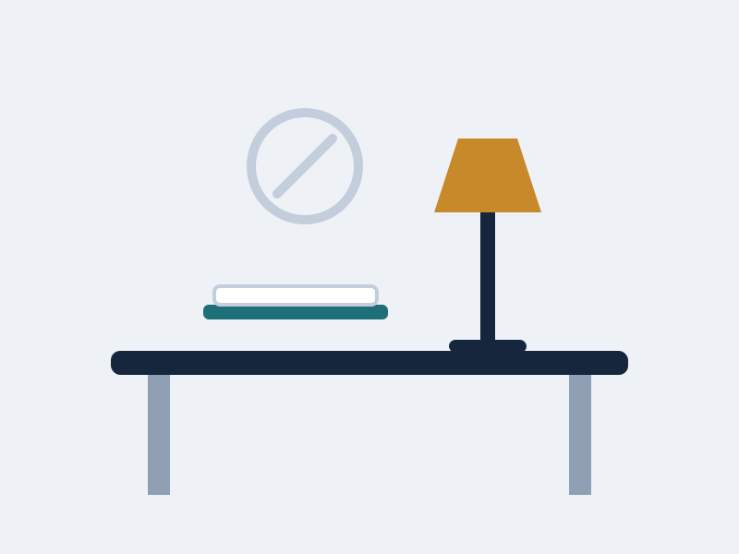


STUDENT PROFILE
H
Strengths and Preferences, and Play
Strengths and Preferences
Writing
Guitar
A small team
A quiet space
Short lists
Play
Music
Writes songs
One or two friends
Not big crowds
Quiet at home
Start with what he can do.
Notes:
Presenter 2. Strengths first, then Play. Keep it short — the pictures carry it.

Slide 4






COMMUNICATION
H
How he takes it in, and how he tells us
Receptive
Expressive
how he takes it in
how he tells us
Short, calm sentences
Writing is clearer than talking
One instruction at a time
A break card means he must leave
Write it down as well
1
2
3
4
5
1 = I need to leave now 5 = I am doing well
Give him time to answer
Believe he can do it. Do not speak for him.
Notes:
Presenter 2. Receptive — how he takes information in. Expressive — how he tells us what he needs.

Slide 5






LEARNING STYLE
H
Every struggle has an answer beside it
Struggles when...
What helps him learn best
No sleep
Short list
Work piled up
Small steps
Too loud
Quiet space
Only spoken
Write it down
Seen as bad
Use the plan
Notes:
Presenter 3 starts here. The captions are prompts only — say the full pair out loud. He has not slept well, so give a short list. Work has piled up, so give it back in small steps. The room is too loud, so offer a quiet space. It was only spoken, so write it down. His illness is seen as bad behaviour, so use the safety plan.

Slide 6




OTHER, AND THE PROGRAM
H
Adapted: same Grade 10 goals, different road there
Other
Adapted or Modified
Our decision
Adapted program
Same Grade 10 goals. We change how he learns.
Doctors and school
A safety plan
Family manage medicine
Risk checked by plan
A flexible timetable
What the EA does
Extra time after illness
Follow the plan. Tell staff.
Stay calm and kind.
A quiet room for tests
Write what you saw.
Thank you. Happy to take questions.
Notes:
Presenter 3. The Other information, what the EA does, and the adapted decision. Then close.

